Slide 1

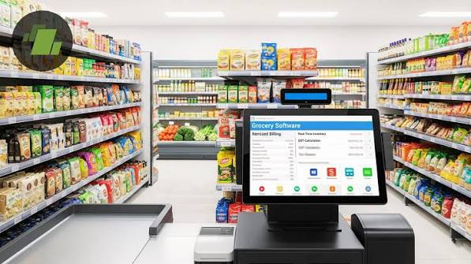
Grocery Store Management

Slide 2
About me :
👤 Name: Manikanta Koushik
🎓 Educational Background:
Bachelor of Technology (B.Tech) in Computer Science and Engineering (CSE) from Hyderabad Institute of Technology and Management (HITAM) Year of Graduation: 2026
📊 Why I Want to Learn Data Analyst: I am passionate about using data to solve business problems. My goal is to build expertise in SQL, Python, Power BI, and Data Analytics to turn data into valuable insights and grow as a Data Analyst.
🔗 LinkedIn: https://www.linkedin.com/in/manikanta-koushik-61a935267/
💻 GitHub: https://github.com/Koushik-Badineni

Slide 3
Agenda
• Project Overview
• Project Objectives
• Database Schema & ER Diagram
• Business Analysis
• Customer Insights
• Product Performance
• Sales Trends
• Supplier Contribution
• Employee Performance
• Key Findings
• Experience & Challenges
• Conclusion • Q & A

Slide 4
Project Overview
Grocery Store Management System
The project focuses on analyzing grocery store transaction data using SQL. A relational database was designed to store customer, product, supplier, employee, and order information. Various SQL queries were written to extract business insights, identify sales trends, and support data-driven decision making.

Slide 5
Objective of the Project
Design and analyze a relational database for a grocery store using SQL.
Perform data analysis to understand customer purchasing behavior and sales performance.
Evaluate product, supplier, and employee contributions through SQL queries.
Generate business reports to uncover trends and support informed decision-making.
Apply SQL concepts such as joins, aggregate functions, subqueries, and window functions to solve real-world business problems.

Slide 6
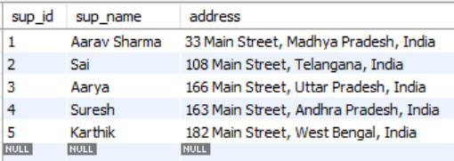
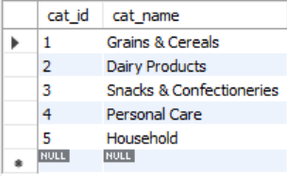
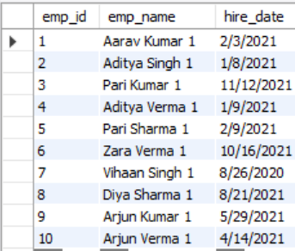
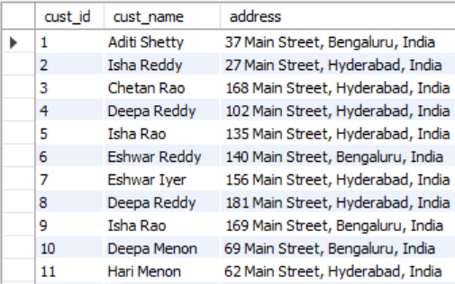
Database Schema
Supplier
category
employees
customers

Slide 7
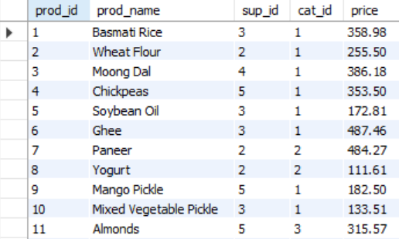
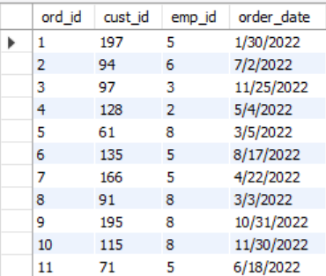
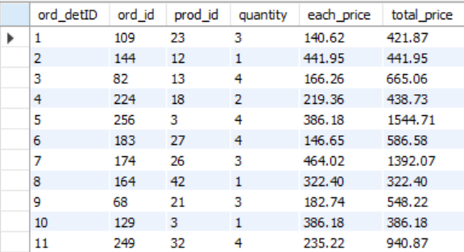
products
orders
Order details

Slide 8
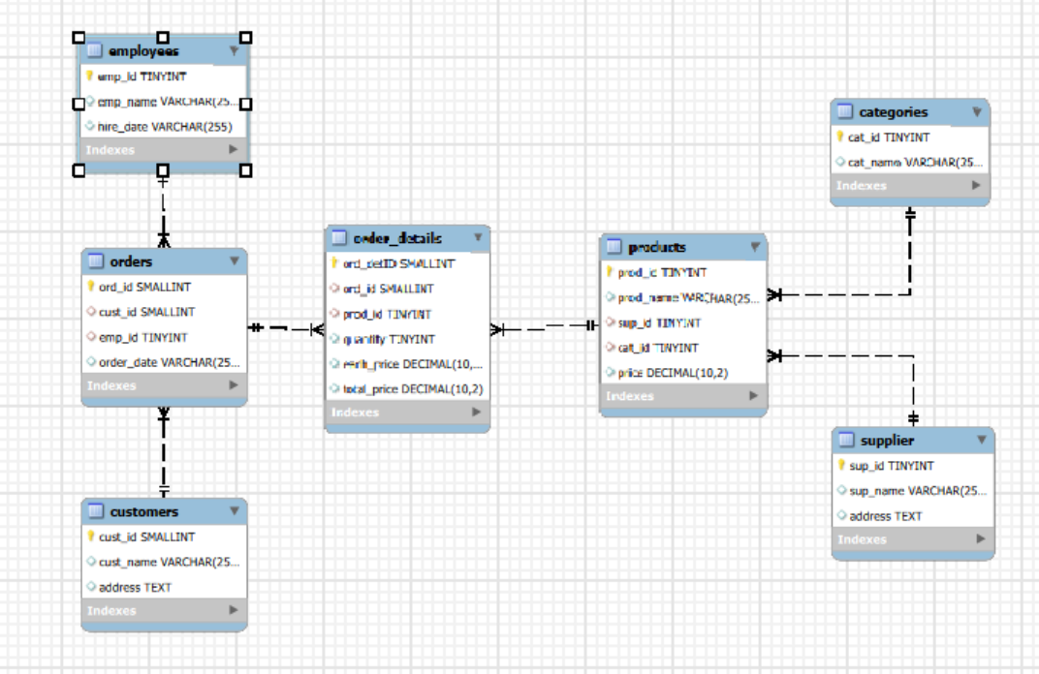
ER Diagram

Slide 9


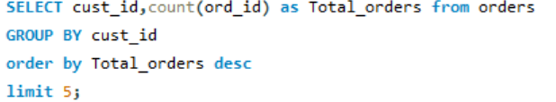
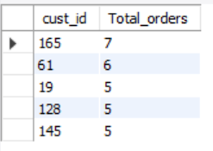
1️. Customer Insights
1A. How many unique customers have placed orders?
1B. Which customers have placed the highest number of orders?

Slide 10
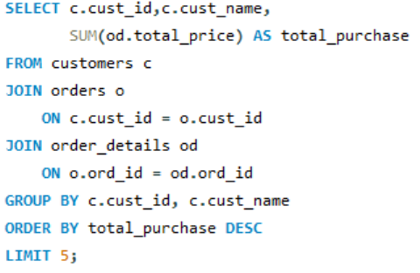
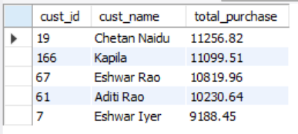
1C. What is the total and average purchase value per customer?

Slide 11
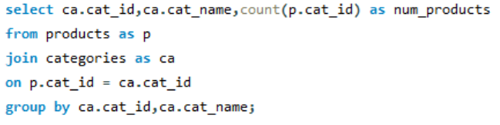
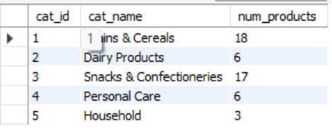
2. Product Performance
2A. How many products exist in each category?

Slide 12
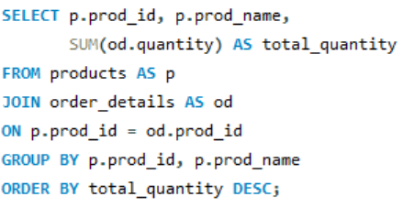
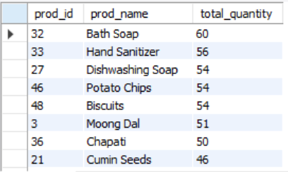
2B. Which products have the highest total sales volume (by quantity)?

Slide 13
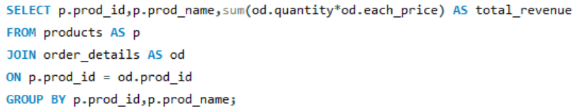
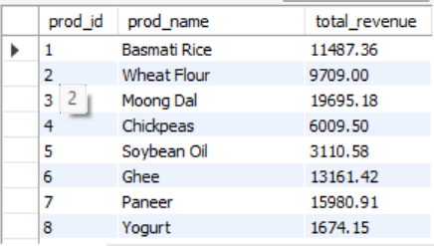
2C. What is the total revenue generated by each product?

Slide 14


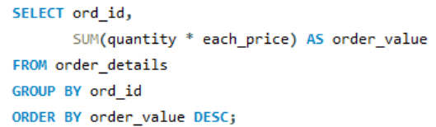
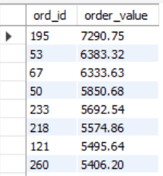
3. Sales and Order Trends
3A. How many orders have been placed in total?
3B. What is the average value per order?

Slide 15
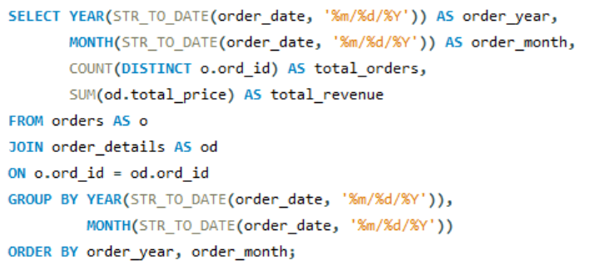
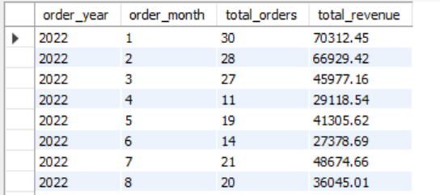
3C. What are the monthly trends in order volume and revenue?

Slide 16


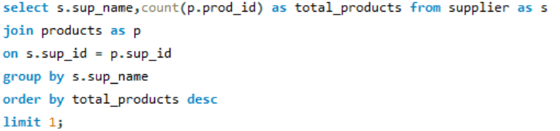

4️. Supplier Contribution
4A. How many suppliers are there in the database?
4B. Which supplier provides the most products?

Slide 17
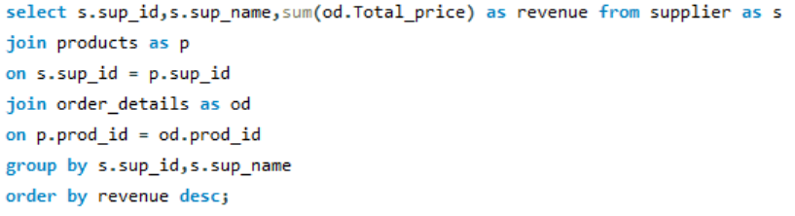
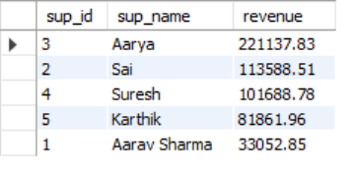
4C. Which suppliers contribute the most to total product sales (by revenue)?

Slide 18
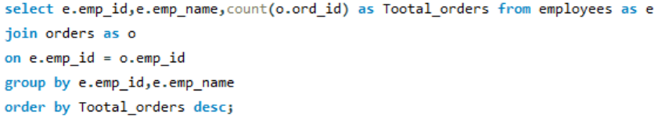
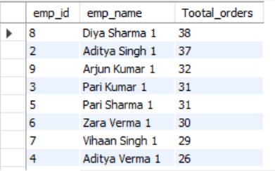
5️. Employee Performance
5A. How many employees have processed orders?

Slide 19
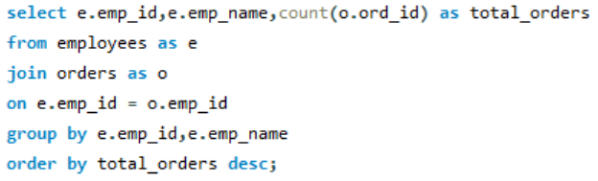
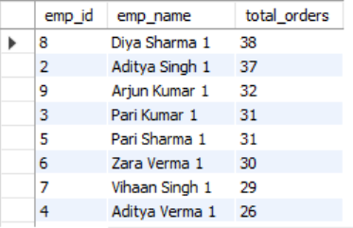
5B. Which employees have handled the most orders?

Slide 20
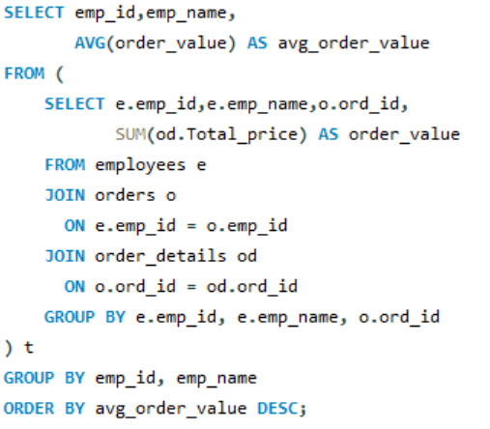
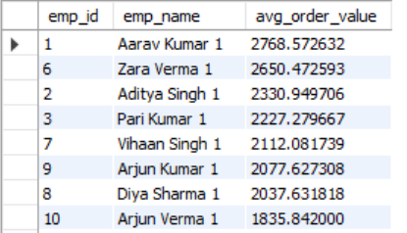
5C. What is the average order value handled per employee?

Slide 21
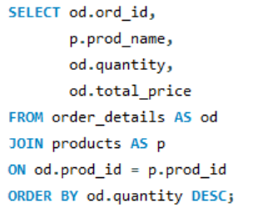
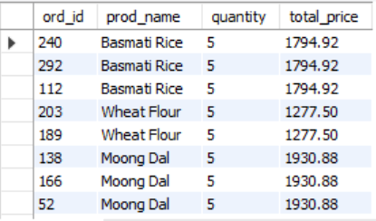
6️. Order Details Deep Dive
6A. What is the relationship between quantity ordered and total price?

Slide 22
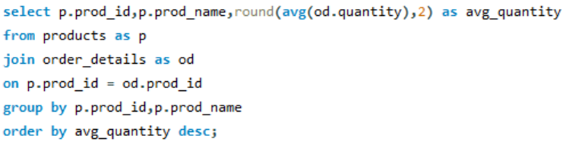
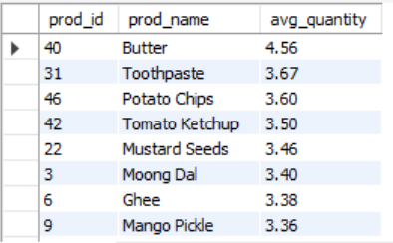
6B. What is the average quantity ordered per product?

Slide 23
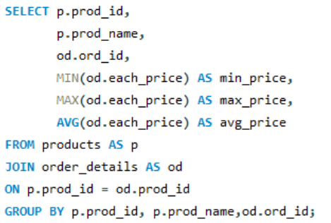
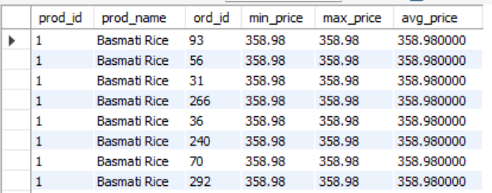
6C. How does the unit price vary across products and orders?

Slide 24
Key Findings
Identified the highest revenue-generating products.
Found the top customers based on purchase value.
Analyzed monthly sales trends.
Evaluated supplier contributions.
Compared employee performance.
Generated business reports using SQL.

Slide 25
Experience
Worked with a structured relational database to manage and analyze grocery store data.
Applied SQL concepts including JOINs, Aggregate Functions, Subqueries, Window Functions, GROUP BY, HAVING, and Date Functions.
Performed data analysis to identify sales trends, customer behavior, and product performance.
Developed analytical thinking by solving real-world business problems using SQL.
Created business reports and dashboards that support informed decision-making through data insights.

Slide 26
Challenges
Designing efficient SQL queries by working with multiple related tables.
Applying advanced SQL concepts such as JOINs, Subqueries, and Window Functions to solve business problems.
Managing date formats and ensuring accurate time-based analysis.
Validating calculations for sales, revenue, customer insights, and business metrics.
Translating business requirements into optimized and meaningful SQL queries

Slide 27
Conclusion
Successfully analyzed the Grocery Store Management database using SQL.
Generated business insights from customer, product, supplier, employee, and sales data.
Applied SQL concepts including JOINs, Aggregate Functions, Subqueries, and Window Functions.
Improved analytical and problem-solving skills through real-world business analysis.

Slide 28

THANK YOU

